Slide 1

Consumer Behavioral System
Presented by :
Y. Jaipal Reddy P. Jay Prakash P. Himabindhu C. Sravya R. Gayathri Sruthi

Slide 2

Scope of the Customer Information System
Provide data for the demand from the customers and data useful for the suppliers.
Provide data for customer purchase behaviour, improve the sales, specific to location for a given timeline ( Monthly, Annually)
Extract information of high value customers and high demand products, that can be used by supply chain department.
Rank items and value customers for sale and offers application.

Slide 3
Logical Architecture
Customer
Customer Dim
Cust_item
Cust_Item
fact
Item
Item dim
Data Load
Dependency

Slide 4
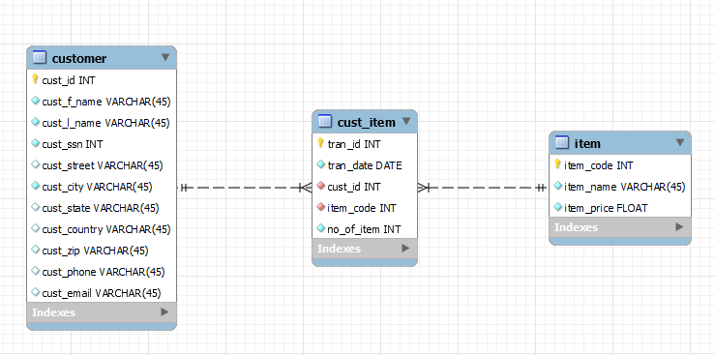
Data Warehouse Schema

Slide 5



Technology Used
Hadoop
HDFS
MapReduce
Hive
Pyspark

Slide 6

Advantages
HDFS
Horizontal Scalability
Cost effective
Fast
Resilient to failure
Can handle large data
Provides the structure on an array of data formats
HIVE
Fast Querying
Partitioning available
Uses HiveQL-a declarative
Real-time stream processing
SPARK
In-memory computation in spark (upto 100x in memory)
RDD(Resilient Distributed Dataset)
Fault tolerance

Slide 7

Data flow diagram
INPUT
HIVE
Client provided data(csv file) stored at system location
Create managed tables and loaded data into hive tables in the datawarehouse
Start
Creating table
Processing data
Output is saved in parquet format in the external table
Partitioned the data and got the summarized sales reports based on
client requirement
End
Visualizing data
Analyzing data
Graphical representation
HDFS and Datawarehouse
PySpark

Slide 8
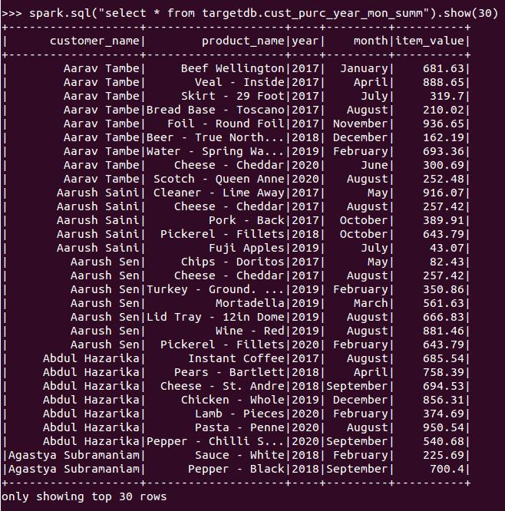
Processed Outputs
OVERALL SUMMERIZED DATA OF PURCHASED PRODUCTS

Slide 9
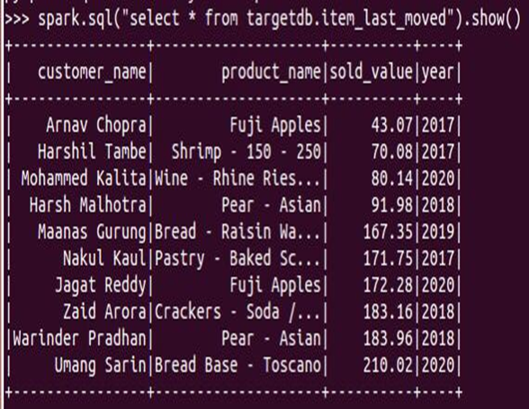
Least purchased items

Slide 10
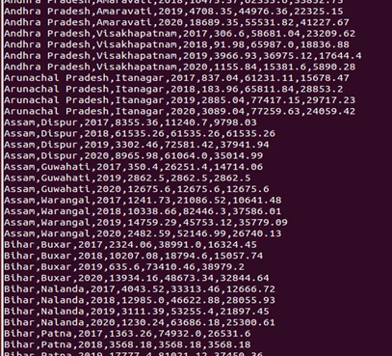
State and City wide sales analysis

Slide 11
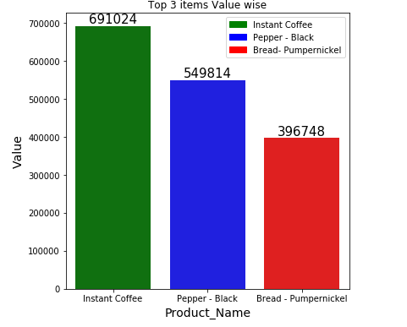
Product analysis

Slide 12

Analysis
The state and city wise analysis have helped us to find the maximum and minimum average sales of the state where Gujarat stood in the top with an average sales of Rs. 451255.46 and Mizoram is the least with an average sales of Rs. 74646.11.
The states Bihar and Nagaland have made the major sales of 20.7% and 17.1% of the total sales of Instant Coffee respectively which is ranked top in the product sales.
We have encountered a maximum purchase of Rs.3994.39 in the year 2019 by the customer Zayyan Malik (cust id: 114).
Fuji Apples is the lest valued product with a sale of Rs.43.07.

Slide 13
Conclusion
Hive helped us to access the data and store it in warehouse and process with the help of hive queries.
Provided data to improve the sales, specific to location for a given timeline ( Monthly, Annually) .
Using Hive and spark customer sales report is prepared with valuable insights.

Slide 14
THANK YOU

